Slide 1
“This Excel dashboard transforms raw social media data into meaningful insights through dynamic slicers, charts, and KPIs. Using Excel formulas, pivot tables, and visuals, it tracks views, watch time, engagement, and retention — enabling users to analyze performance and monitor key content trends in an interactive, decision-ready format”

Slide 2
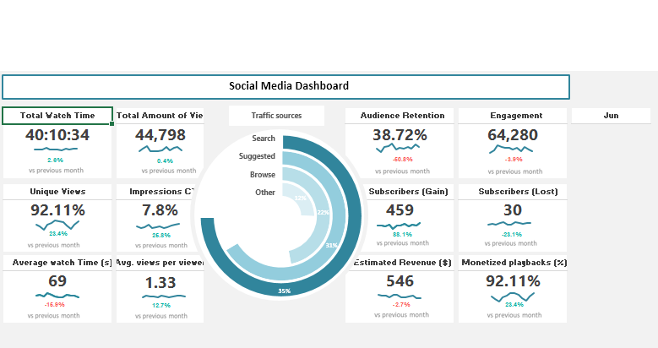
Digital Pulse: Social Media Performance Dashboard

Slide 3
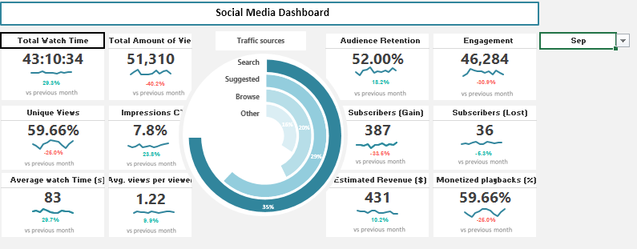
Digital Pulse: Social Media Performance Dashboard

Slide 4
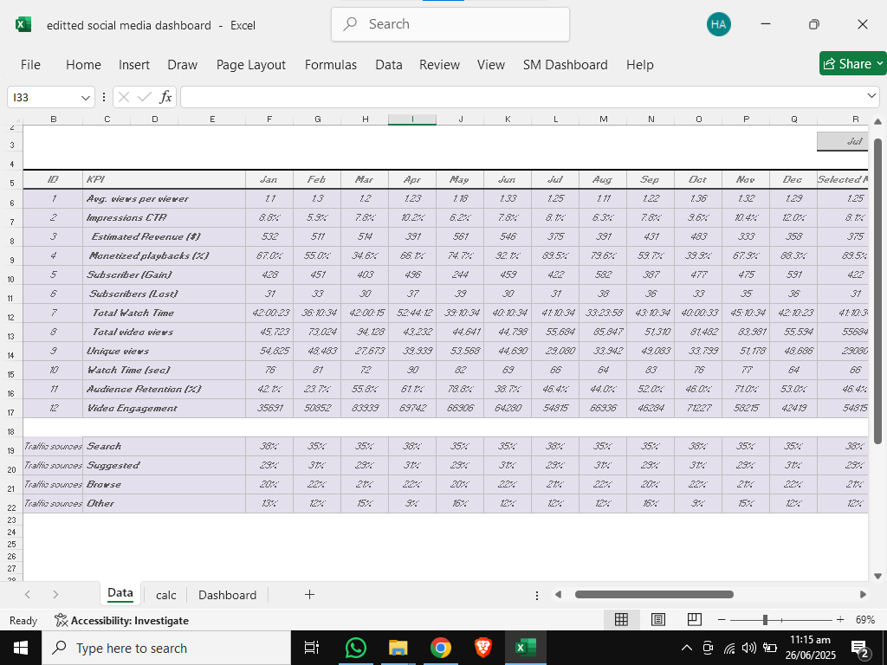
Digital Pulse: Social Media Performance Dashboard
Datafiniti - Stores clean and raw data

Slide 5
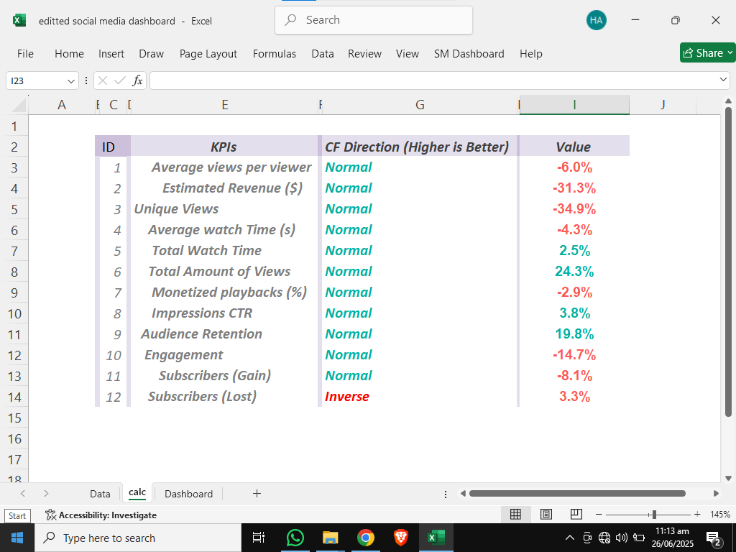
Digital Pulse: Social Media Performance Dashboard
Notebook - Machine Learning Code

